Slide 1
Team Project
Tengyue Chen
Hao Miao
Haoxing Zhang

Slide 2


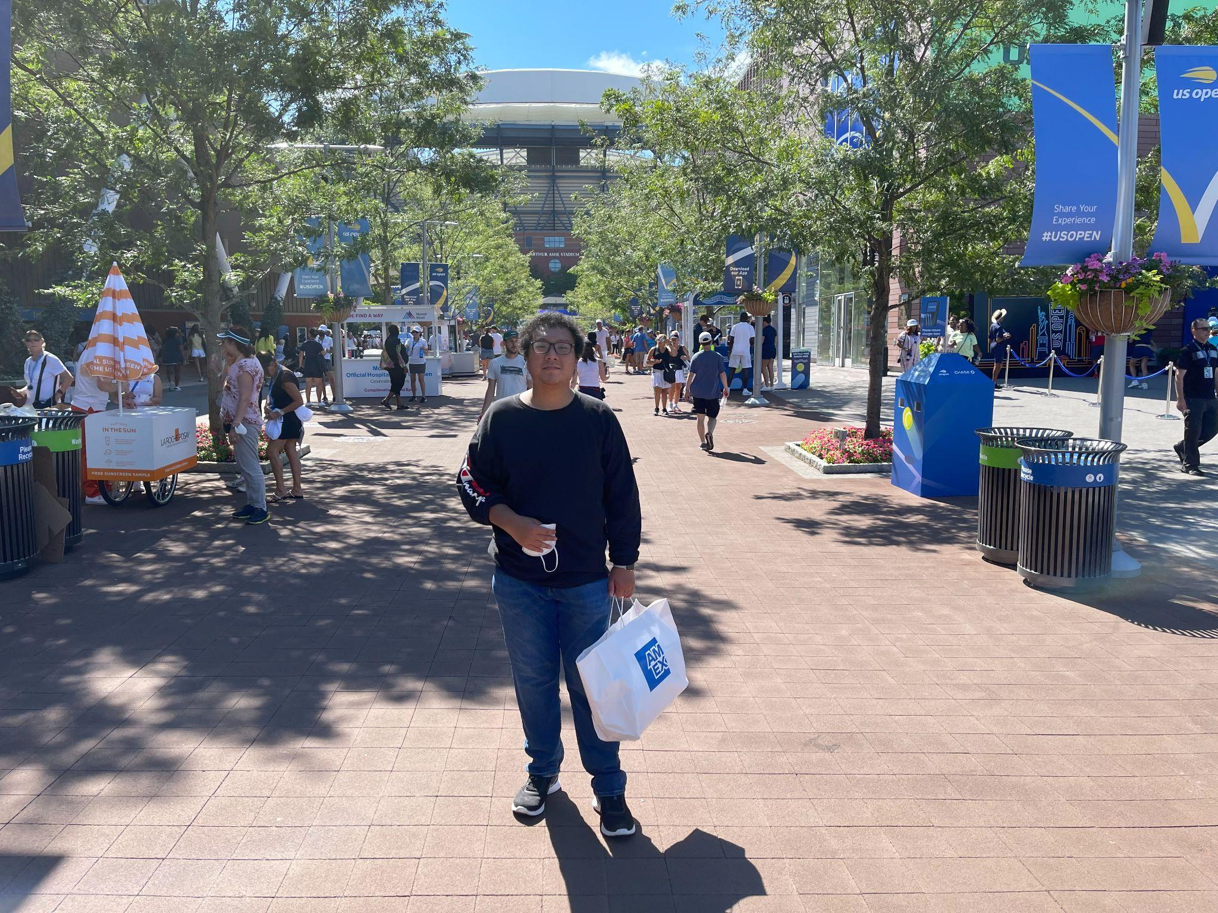
Hao Miao
Major: BIA
Team Members:
Tengyue Chen
Major: BIA
Haoxing Zhang
Major: BIA

Slide 3
Project topic 1 Introduction
Project topic 1: An Analysis of Flight Connections
Goal: Design a model of flight line inputs in the US for airlines using flight data.
Describe: The model can predict the efficiency of flight line through cancellation rates. Therefore, the model can provide a flight input plan for airlines company..
Software: SQL for data clean.
Gephi for build social network model to show the connection between
States.
Python for design a ML model.

Slide 4
Project topic 1 Dataset
The dataset contains information on flights in the United States in June 2022.
U. S. Department of Transportation
https://www.transtats.bts.gov

Slide 5
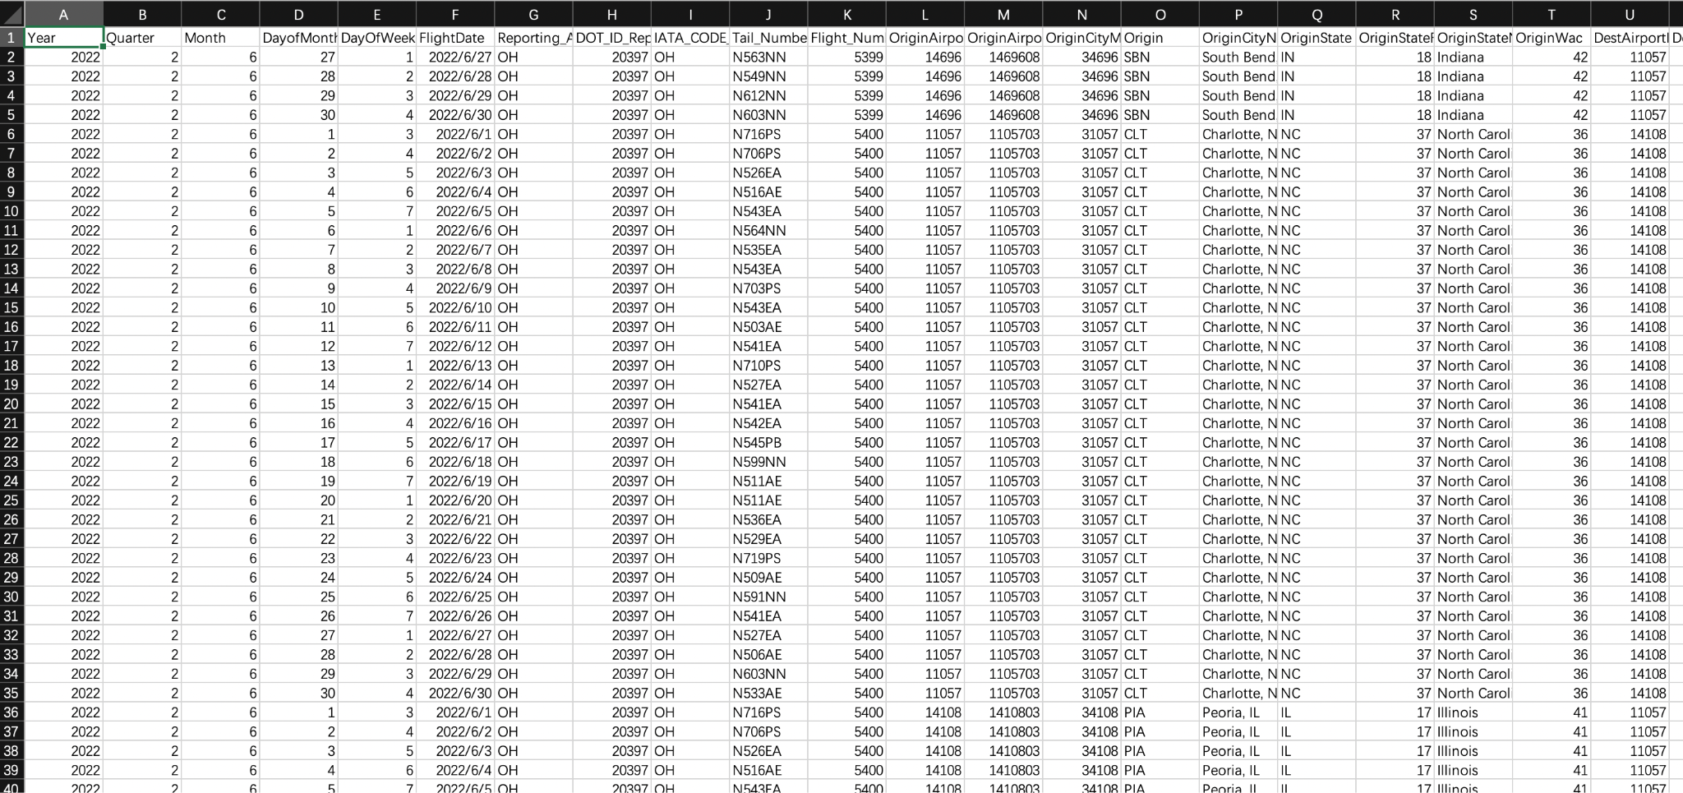

Slide 6
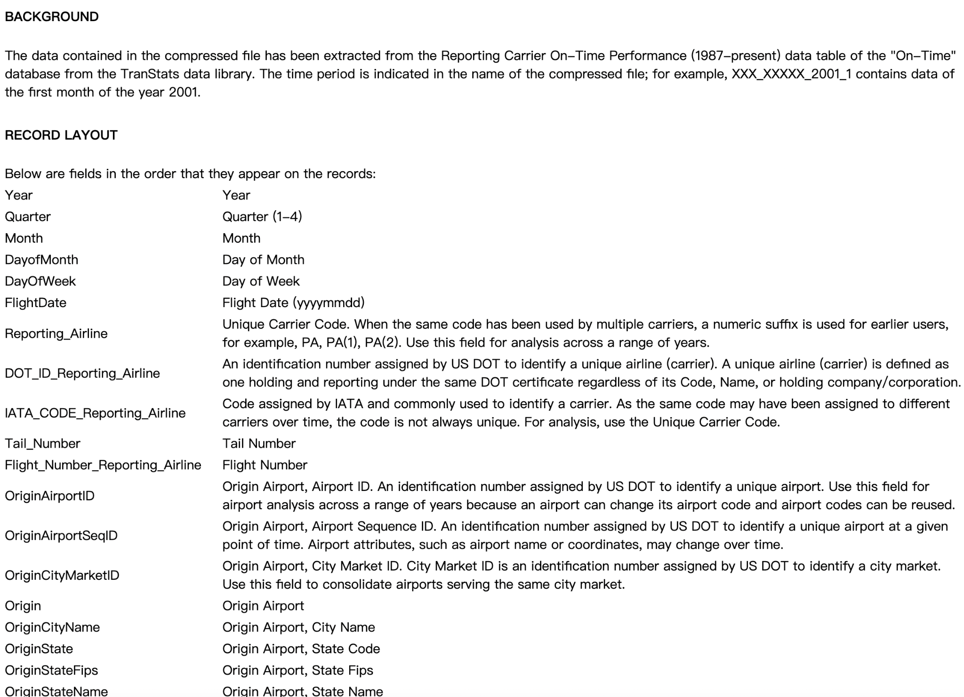

Slide 7
Project topic 2 Introduction
Project topic 1: An Analysis of Follower in Twitch
Goal: Design a model of finding cyber celebrity
Describe: The model can predict the potential cyber celebrity by using multiple variables in the dataset
Software: SQL for data clean and formatting.
Gephi for build social network model
Python for design a ML model.

Slide 8
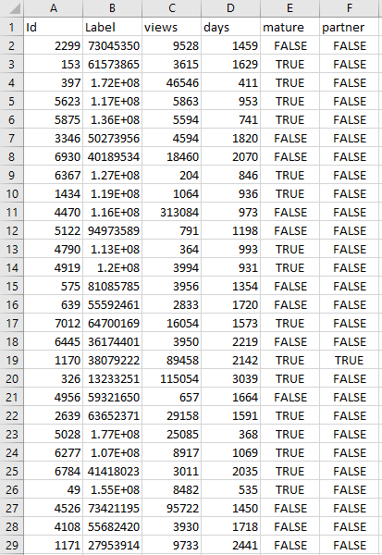
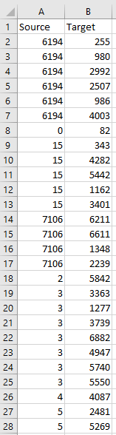
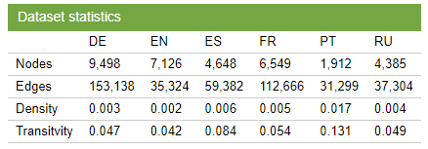

Slide 9
Project topic 2 dataset
Dataset contains following information in Twitch
Source from: SNAP:Network datasets:Wikipedia
Article Networks(Stanford.edu)

